Slide 1
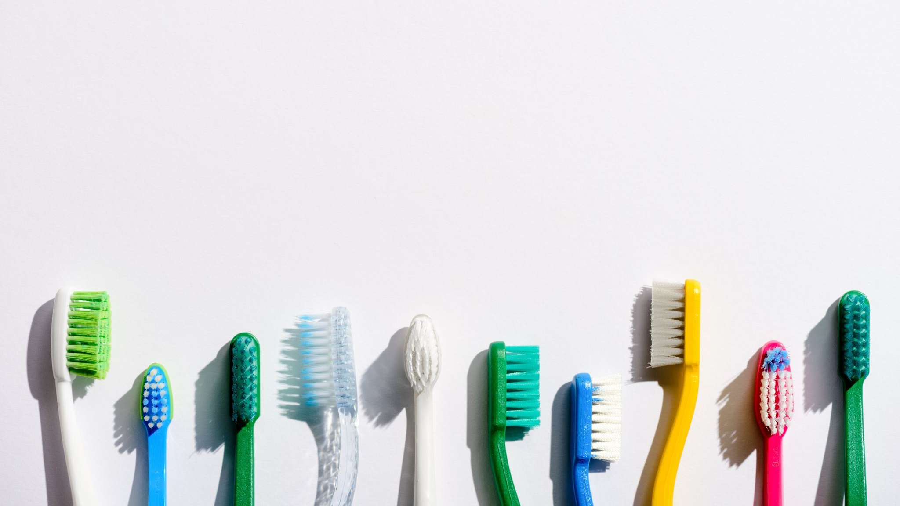
Oral Health for Patients in ISL
Allie Cook, Anna Belle Wakeland, Breighlee Zimmerman, Shannon Greene
Missouri Southern State University Dental Hygiene Program

Slide 2

Pre-Quiz

Slide 3
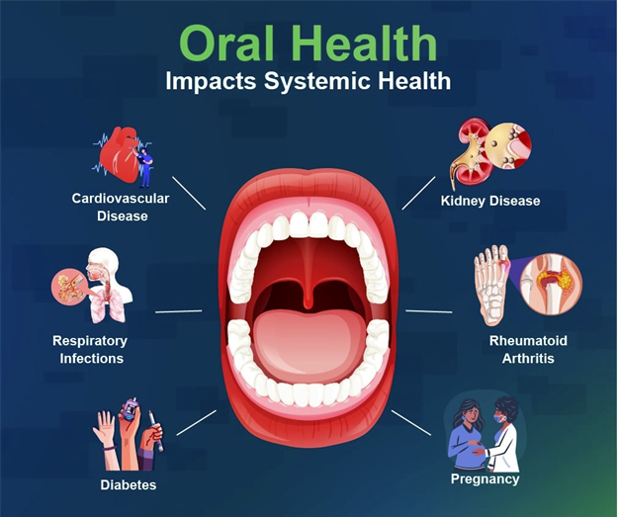
Introduction
Oral and systemic health connection
Impact of nutrition
Medication side effects
Caregiver impact

Slide 4
Objectives
Caregivers will help plan meals and snacks and include one tooth‑friendly option in two meals each weekday, such as water or lower‑sugar foods.
Caregivers will teach and help with tooth‑brushing every morning and night, showing each step and modeling good brushing to build healthy habits and prevent cavities.
Caregivers will note one oral‑health side effect from each person’s medication—such as dry mouth or gum sensitivity—and record it in a weekly report.

Slide 5

Nutrition
How does what we eat affect our teeth?
Frequent exposure to cariogenic (decaycausing) foods feed the bad bacteria in our mouths.
The more often our mouths are exposed to this bacteria, the higher the risk of developing cavities there is.

Slide 6
Nutrition
Options to combat decay:
Eliminate cariogenic foods
Brush teeth after consumption
Swish with water afterwards
Add anticariogenic (decay fighting) foods to diet

Slide 7

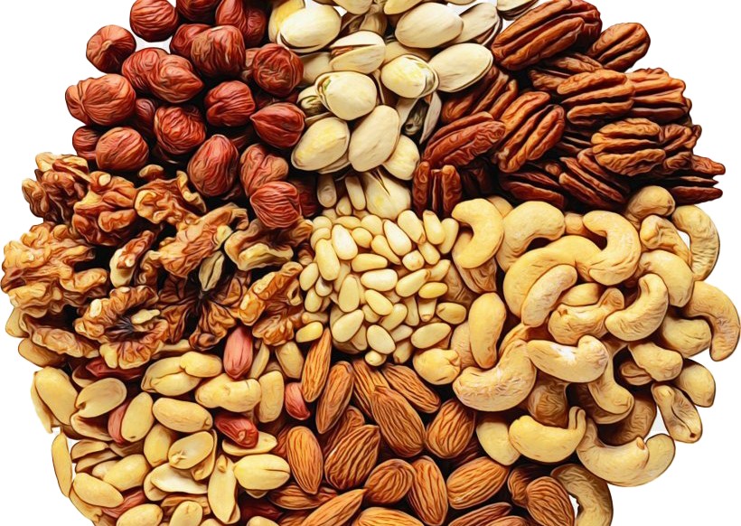
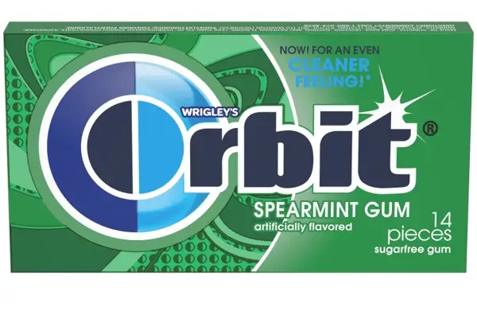

Nutrition
Examples of anticariogenic foods (decay fighting foods):
Fresh fruits and vegetables
Xylitol (found in sugar free gum)
Dairy products
Nuts and seeds
Weekly meal planning should try to include some of these foods daily

Slide 8
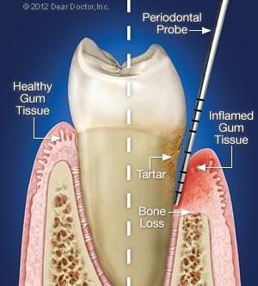
Benefits of Oral Hygiene
Prevention of cavities
Prevention of periodontal disease and tooth loss
Improved speech and communication
Reduced emergency interventions and hospital visits
Improved overall health

Slide 9
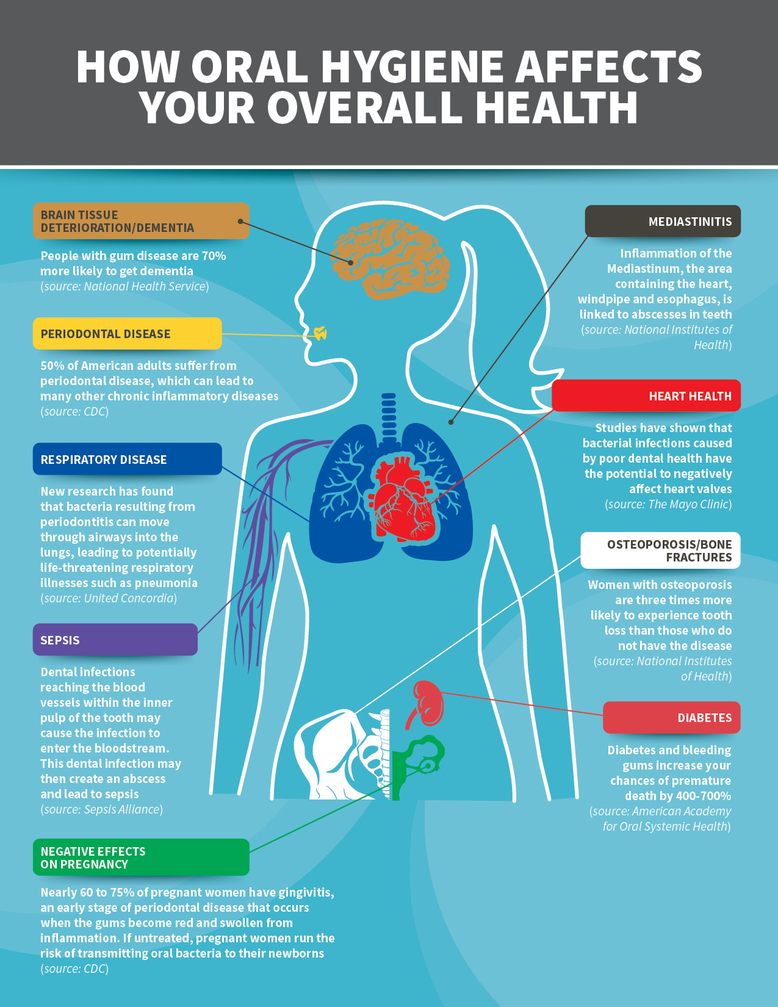
Importance of Oral Hygiene
Increases Comfort and Quality of Life
Oral health directly affects systemic
health
Supports nutrition and eating
"Oral care isn't cosmetic- it is medical care."

Slide 10
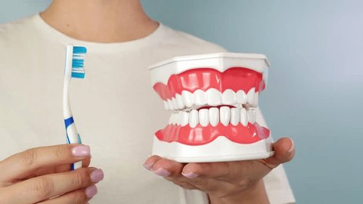
Oral Hygiene Care Tips
Brush 2 times day for 2 minutes, and floss at least once per day
Electric toothbrushes are best!
Swish with water between meals
Limit frequent exposure to sugar
Wait at least 30 min to brush after eating acidic foods/drinks

Slide 11
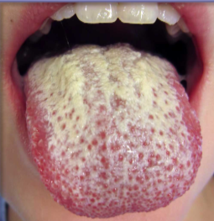
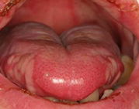
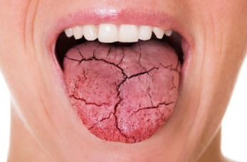
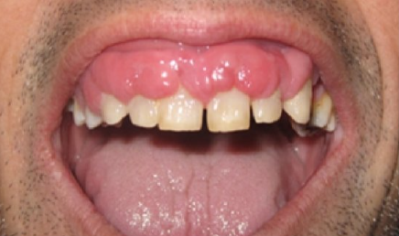
Medication
Tracking symptoms
Common examples
  Dry mouth
  Fungal infection (from inhalers)
  Gum overgrowth
  Inflammation of mouth lining
Mucositis
Fungal Infection
Gingival Overgrowth
Dry mouth

Slide 12
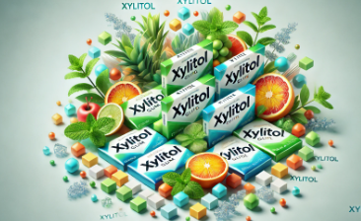
Medication Cont.
Practical solutions
  Xylitol chewing gum
  Rinse mouth after using inhaler
  Regular oral hygiene
  Clean oral appliances
Implementation of tracking report
  Report signs and symptoms in mouth 1x weekly
  Frequently occurring side effects messing with patients' comfort
    Report to primary physician

Slide 13
Overview
build daily routines
support healthier eating
better brushing habits
awareness of how medications can affect oral health
encourage long‑term healthy habits

Slide 14
Post-Quiz

Slide 15
Questions?

Slide 16
References
Miller, K. (2025, February 1). Oral side effects of medications. WebMD. https://www.webmd.com/oral-health/oral-side-effects-of-medications

