Slide 1
Ethical Dilemma-
Truth or consequences
By Grace Haley, Chloe Seme, and Breighlee Zimmerman

Slide 2
Truth or Consequences
"Robert Parks is a dental hygienist employed by Dr. Samuel King in his posh downtown office. Robert has worked for Dr. King since 2010, although at times they have disagreed on various office issues. Robert has been very vocal about his views and his dislike for Dr. King. They have had loud shouting matches often, which have been overheard by the office staff. Dr. King has been very unhappy with Robert's attitude feeling that it negatively impacts and compromises the dental care that his patients are receiving. His concern is that his patients can feel the tension in the office. Dr. King recently expanded and updated the office, adding 4 new operatories, new computer systems, and became totally digital. Robert loves all the "bells and whistles" and knows it will be difficult to find a full-time position in such a "state of the art" practice. Robert is certified in local anesthesia and routinely gives injections to his patients. In accordance with OSHA guidelines, Robert places the used contaminated needles which are protectively capped, into the sharp's container. However, a couple of months ago, according to Robert, Dr. King changed the procedure. He now requires the office staff to remove the protective caps from the contaminated needles before putting the needles into the disposable sharp's containers. Robert alleges this was done as a cost saving measure, reducing the frequency of disposal of the sharp's containers. Robert is concerned about the hazards of a needle stick with a contaminated needle. In his rage, Robert filed a complaint with the Occupational and Safety Administration. As a result, a full investigation was conducted in the practice. Dr. King became so upset with Robert's actions that he fired him on the spot. Both parties are suing each other and are involved in a messy court case."

Slide 3
Ethical Dilemma
Conflict and hostility between Dr. King and Robert create an unprofessional work environment that compromise the safety and comfort of the patients.
Dr. King's policy for protocol of contaminated needs and removing their caps prior to placement into the sharps container for cost-saving measures violates OSHA and leads to potential harm for the staff.
But should Robert follow these unsafe procedures established by the doctor in charge, or should he speak out against the doctor to ensure workplace safety in accordance with OSHA guidelines and risk the possibility of losing or leaving his job at the office that he enjoys working in?

Slide 4
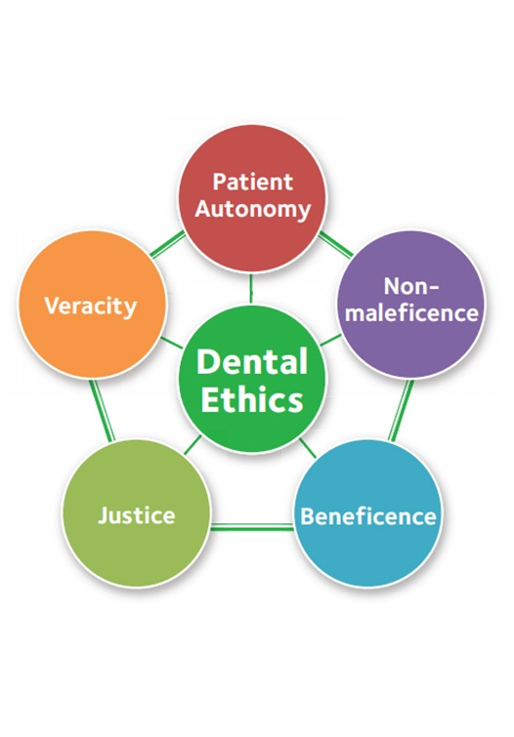
Core Values
Beneficence and Nonmaleficence
  Demonstrated when Robert reports incident to OSHA to prevent harm that may occur from Dr. Kings unsafe protocol of uncapping needles prior to disposal in the sharp's container
Veracity
  Demonstrated when Robert reports the issue and truth to OSHA regardless of its consequences, rather than staying quiet to keep his position at this office
Justice
  Violated by Dr. King's action of firing Robert in response to Roberts claim to OSHA
ADA Principal of Ethics | Westcliff Family Dentistry. (n.d.). Www.westclifffamilydentistry.com. https://www.westclifffamilydentistry.com/ada-principal-of-ethics.html
‌

Slide 5
Additional Information
Prior to the current conflict, Robert and Dr. King were involved in various disagreements involving the dental office, many leading to yelling matches.
Robert is vocal about his dislike for Dr. King; Dr. King feels that Robert's attitude is interfering with the office and patient care.
This information enforces the idea that if they had not had prior conflict, the situation may have been discussed and resolved within the office before involving OSHA or firing an employee
Robert made assumptions that Dr. King did it for cost-saving measures
Robert recognizes that with Dr. King's updated equipment, it would be difficult to find another job like the one he has.

Slide 6
Options
Robert ignores the dilemma at hand and complies with Dr. King's new policy to remove the caps from the contaminated needles before placing them in the sharps container.
  Violates OSHA, violates Roberts ethical integrity and legal obligation.
  Violates nonmaleficence, beneficence, and veracity.
Robert does not comply with Dr. King's new policy and reminds his coworkers that it is not ethical, nor safe.
  Insubordination
  Promotes nonmaleficence, beneficence, and veracity.
Robert approaches Dr. King about the danger of the new policy in hopes that Dr. King would realize his mistake and change the procedure.
  If Dr. King does not change the policy, Robert should then file a complaint and risk losing his job.

Slide 7
Our Choice
Option 3
  Robert would first have a private conversation with Dr. King and address the new procedure and its dangers to the office staff in addition to legal obligations.
  If Dr. King does not respond appropriately and return to standard procedure, Robert should then approach OSHA and file a report on the unethical practices within the office.
  Robert may also report Dr. King to the ADA for being non-compliant with the legal obligations of his practice.

Slide 8
Justifying
Option #3 supports the ethical principles of nonmaleficence, beneficence, and veracity while allowing the issue to be resolved internally before involving outside sources.
Professionalism is maintained as Dr. King is made fully aware of the implications of his actions and is aware that Robert will be left with no other option but to file a report if he does not comply with OSHA standards.
The negative aspect of this choice is that it may come with personal repercussions. Robert may be fired or faced with resignation. However, this is the most ethical decision as it protects both his licensure and the safety of the dental team.

Slide 9
Implementing
With this decision, Robert decided to address and support change within the organization prior to notifying OSHA about the improper needle disposal procedure.
This decision may cause a delay in the adjustment of the procedure, risking the safety of employees within the office.

Slide 10
Sources
ADA Principal of Ethics | Westcliff Family Dentistry. (n.d.). Www.westclifffamilydentistry.com. https://www.westclifffamilydentistry.com/ada-principal-of-ethics.html
ADHA Code of Ethics. (2024). https://www.adha.org/wp-content/uploads/2025/03/ADHA-Code-of-Ethics_FY24_10_18.pdf
Kimbrough-Walls, V. J., & Lautar, C. J. (2012). Ethics, jurisprudence, & practice management in dental hygiene (3rd ed.). Pearson.

