Slide 1


Digital Clinical Case Study
Missouri Southern State University Dental Hygiene Program
DH 0295: Seminar in DH I
By: Breighlee Zimmerman

Slide 2

Section I
Basic Information

Slide 3

General Characteristics of Patient
John Case
Name: John Case​
Eaglesoft ID: 15370
Age: 30
Gender: Male
Race: White
Chief Complaint: None

Slide 4
Social History
Marital/Relationship Status: Single
Occupation: HVAC services (heating and cooling)
Children: 1 daughter, 9 years old
Education: High school diploma

Slide 5
Dental History Summary
Oral Symptoms: No current symptoms
Last Dental Visit: Last dental cleaning completed in 2013 during middle school years
Oral Hygiene Routine: Brushes 1x per week and never flosses

Slide 6
Economic Influences
Socioeconomic Status: Low socioeconomic status (patient mentions struggling to pay bills and lives with sister)
Dental Insurance: Uninsured

Slide 7
Patient's Attitude and Behavior
Beginning of Treatment: Patient was eager to receive treatment and improve qulaity of teeth, patient was unaware of the condition of his oral cavity
During Treatment: Patient was willing to listen to advice and education provided during appointments. He agreed to receive nutritional and tobacco cessation counseling and listened attentively, but struggled to implement changes

Slide 8
Section II
Objective Data

Slide 9
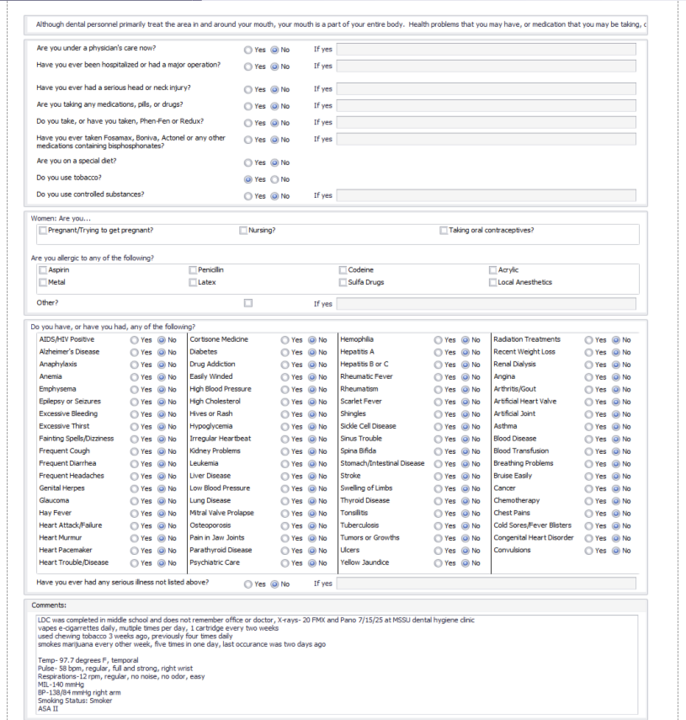
Medical and Health History

Slide 10
Medical and Health History
No primary care physician
No medical conditions or diseases
No surgeries
Tobacco Use: Smoker, vapes e-cigarettes multiple times per day, 1 cartridge every two weeks; smokes marijuana every other week 4x per day; previously used chewing tobacco 3x every day, last occurrence was 8/26/25
ASA II
Alcohol Consumption: social drinker, 1-2 drinks every 6 months

Slide 11
Medical and Health History Continued... Vitals
Temp- 97.9 degrees F, temporal
Respirations- 14 rpm, regular, no noise, no odor, easily felt
MIL- 150 mmHg, right arm
Blood Pressure- 138/88 mmHg, right arm
Pulse- 74 bpm regular, full and strong, left wrist
Appointment 1 Vitals- 9/16/25:​
Temp- 97.7 degrees F, temporal
Pulse- 58 bpm regular, full and strong, left wrist
Respirations- 12 rpm, regular, no noise, no odor, easily felt
MIL- 140 mmHg, right arm
Blood Pressure- 138/84 mmHg, right arm
Appointment 2 Vitals-11/15/25:​

Slide 12
IntraOral/Extraoral Exam (EOIO)

Slide 13
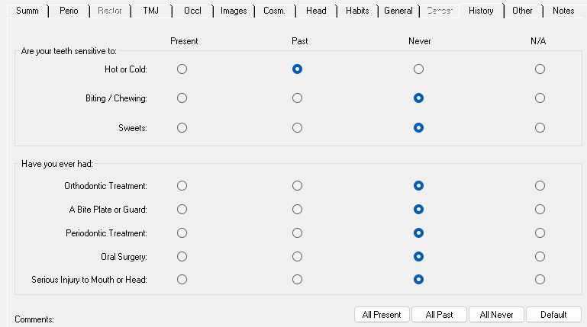
EOIO: history
Last dental cleaning: in middle school in 2013, patient does not recall office or doctor
Last x-rays: unknown, but most likely during childhood
Past sensitivity to cold drinks and foods, no longer frequent
No oral surgeries, patient still has wisdom teeth
No chief complaint

Slide 14
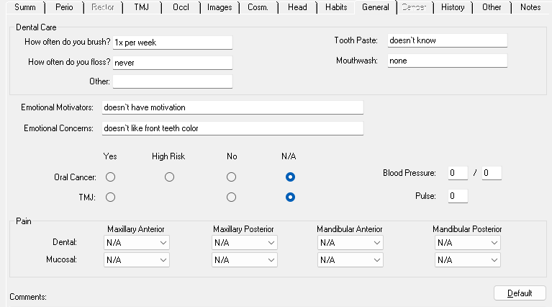
EOIO: General
Patient uses a manual toothbrush once per week
  Intervention: Educate patient on electric toothbrushes
  Outcome: Reduced plaque accumulation
Patient never flosses
  Intervention: Educate patient on c-shaped flossing technique at least once a day, try using floss picks
  Outcome: Interproximal plaque removal
Lack of mouthrinse
  Intervention: Educate patient on how antimicrobial mouth rinses can improve gum health
  Outcome: Avoid halitosis and prevent halitosis, plaque and biofilm accumulation, and gingivitis

Slide 15
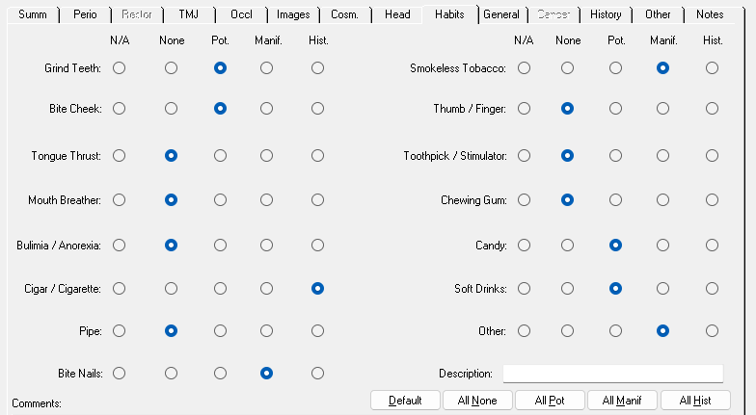
EOIO: Habits
Grinds Teeth- pt reports it may may be present while he sleeps
  Intervention: Recommend a night guard and educate patient on impacts on enamel
  Outcome: Reduced attrition and TMJ pain
Bites Cheek- possibly due to occlusion
  Intervention: Recommend cessation or replace with gum containing xylitol
  Outcome: reduced caries and reduction of tissue trauma
Patient reports a history of smoking cigarettes but claims he no longer does and switched to marijuana use
Bites Nails- happens when anxious
  Intervention: Education on self-relaxation techniques and impacts on enamel
  Outcome: reduced attrition and wear on enamel structure
Patient reports he had a history of smokeless tobacco use
Soft Drinks & Candy- frequently uses
  Intervention: Education on acid exposure and impacts on enamel including erosion, maintain exposures to mealtimes in order for proper maintenance of pH levels and allow the production of saliva
  Outcome: Reduced caries
High Sweet Tea Consumption
  Intervention: Recommend replacement with water or limitation of these beveraees
  Outcome: Reduced caries

Slide 16


EOIO: Head
Facial hair
Eczema on the neck, flaky dry skin
3x4mm flat macule on neck
2x2mm pimple on neck
2 2x2mm macules on inferior lip and near right labial commissure & grouped on superior lip
Bilateral linea alba
Severe bitemarks near posterior molars, raised pink area 5x4mm on left buccal mucosa
White coating on the dorsal surface of the tongue
Absence of inferior labial frenum
Bilateral mandibular tori
Palatal tori
Bilateral scalloping of the tongue
Exostosis near mandibular posteriors

Slide 17
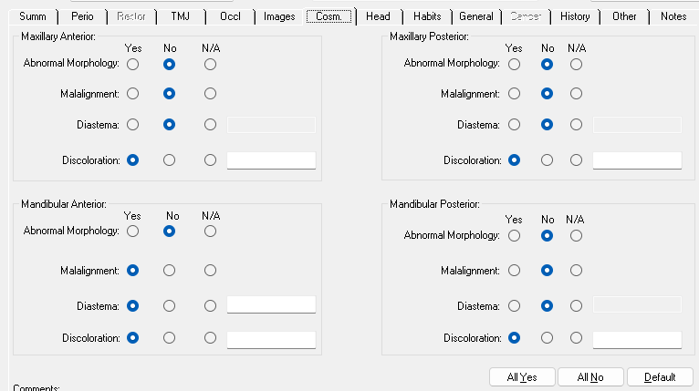
EOIO: Cosmetic
Stain Statement: Generalized moderate intrinsic yellow staining
Attrition Statement: Generalized slight attrition in the posteriors with localized moderate attrition in the maxillary anteriors
Black staining on occlusal surfaces of 1,3,5,13
Blackish-brown staining on 17,19,30,32
Brown staining on 3-O&F, 9-F
Suspicious white spot lesions on F of 8&9
Missing mandibular lateral incisors #23&26
Partially erupted #17&32
Chip on #19-O&27
Diastemas: 1mm #21&22, 1mm #24&25, 3mm #25&27, 3mm #27&28, 2mm #5&6

Slide 18
EOIO: Habits
Grinds Teeth- pt reports it may may be present while he sleeps
  Intervention: Recommend a night guard and educate patient on impacts on enamel
  Outcome: Reduced attrition and TMJ pain
Bites Cheek- possibly due to occlusion
  Intervention: Recommend cessation or replace with gum containing xylitol
  Outcome: reduced caries and reduction of tissue trauma
Patient reports a history of smoking cigarettes but claims he no longer does and switched to marijuana use
Bites Nails- happens when anxious
  Intervention: Education on self-relaxation techniques and impacts on enamel
  Outcome: reduced attrition and wear on enamel structure
Patient reports he had a history of smokeless tobacco use
Soft Drinks & Candy- frequently uses
  Intervention: Education on acid exposure and impacts on enamel including erosion, maintain exposures to mealtimes in order for proper maintenance of pH levels and allow the production of saliva
  Outcome: Reduced caries
High Sweet Tea Consumption
  Intervention: Recommend replacement with water or limitation of these beveraees
  Outcome: Reduced caries

Slide 19
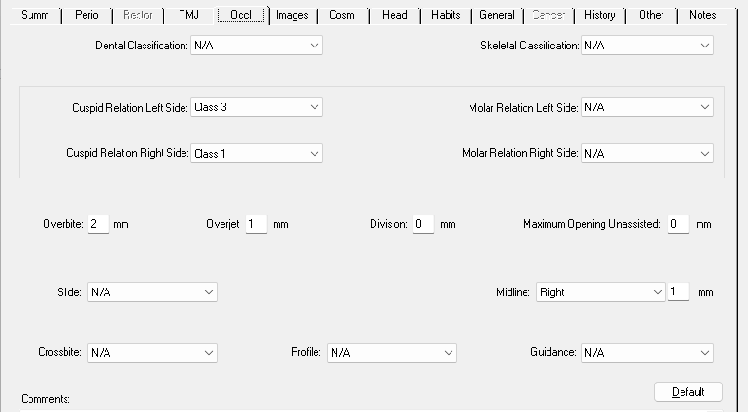
EOIO: Occlusion
Right Molar: Class I
Right Canine: Class I
Left Molar: Class III
Left Canine: Class III
Slight overbite 2mm
Midline deviation to the right 1mm
Slight overjet 1mm
#3&30 edge-to-edge

Slide 20
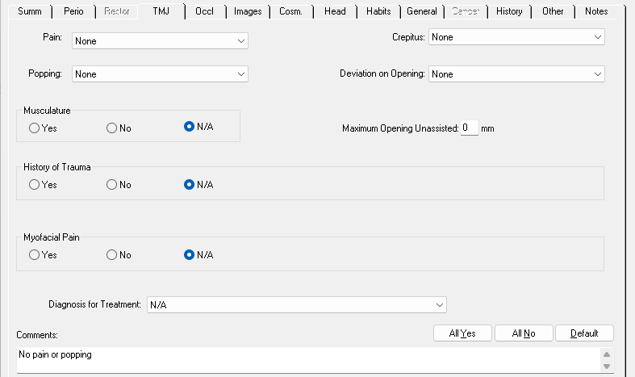
EOIO: TMJ
Patient has no present or history of pain and popping, no deviation on opening, and no crepitus

Slide 21
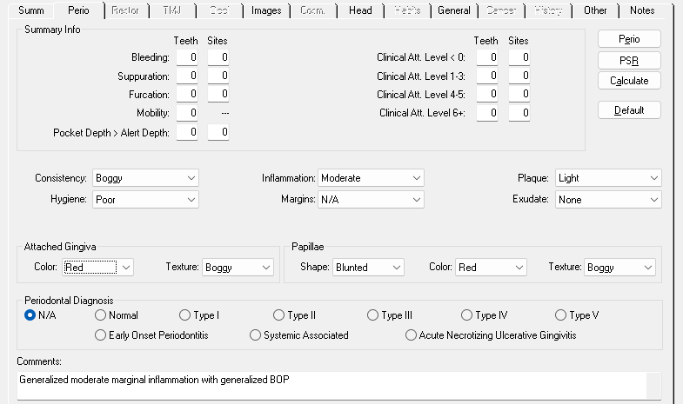
EOIO: Perio
Consistency: Boggy
Inflammation: Moderate
Plaque: Light
Hygiene: Poor
Margins: Swollen
Exudate: None
Attached gingiva: red and boggy
Papillae: blunted, red, and boggy
Gingival Statement: Generalized moderate marginal inflammation with generalized BOP

Slide 22
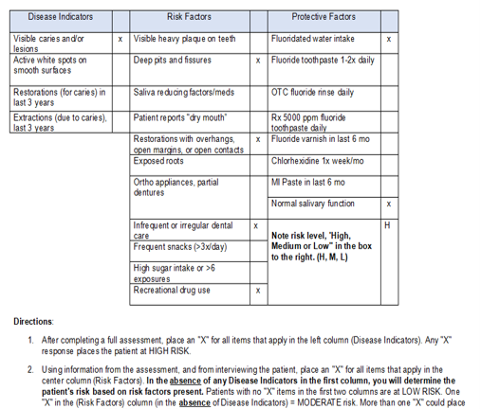
Caries Risk Assessment
Caries Risk Status: High
Disease Indicators: Presence of caries or lesions on tooth surfaces
Risk Factors: use of marijuana, open contacts and embrasure spaces to due missing teeth, and infrequent dental office visits due to lack of insurance
Environmental Factors: During childhood, patient lacked fluoridated water due to the consumption of well-water during childhood
Protective Factors: Patient has normal salivary flow and is on city water now
Diet: Patient consumed a large amount of carbohydrates with high sugar, as well as sweets like ice cream, and lack fruits, vegetables, and dairy products

Slide 23
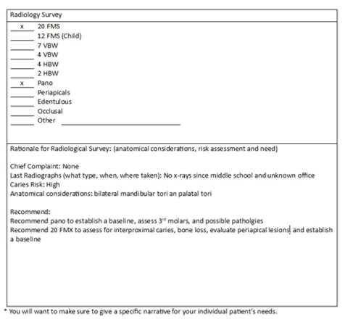
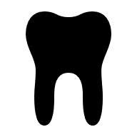
RADIOLOGY treatment plan
Recommended:
20 FMX
Pano

Slide 24
Radiographs...

Slide 25
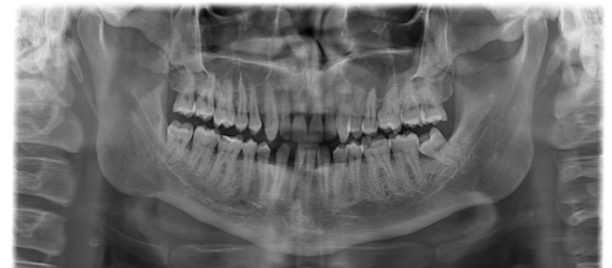
Panoramic
Taken at MSSU on 7/15/25

Slide 26
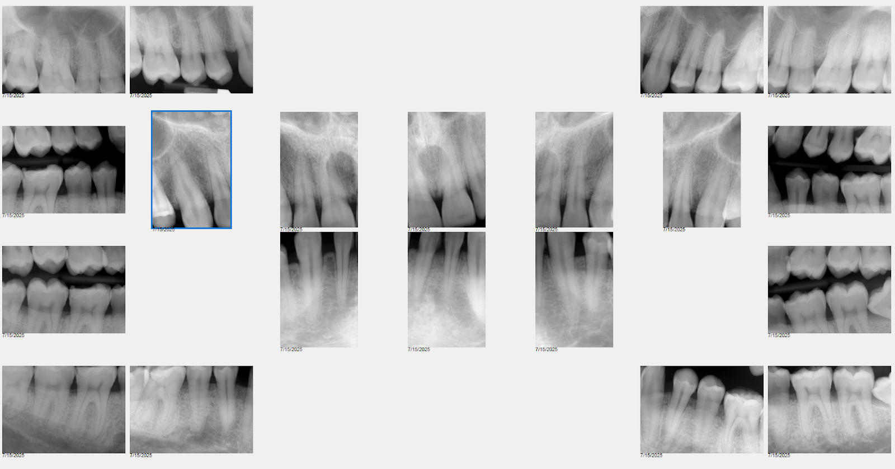
20 FMX
Taken at MSSU on 7/15/25

Slide 27
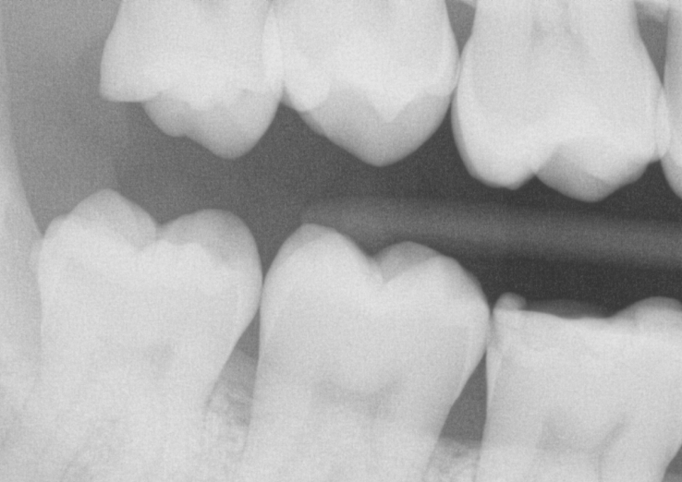
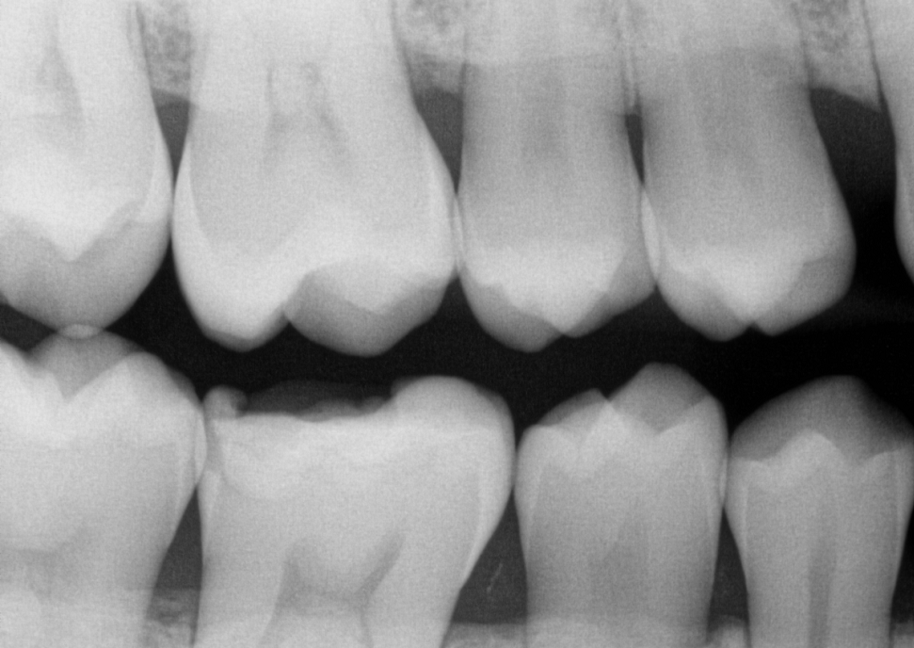
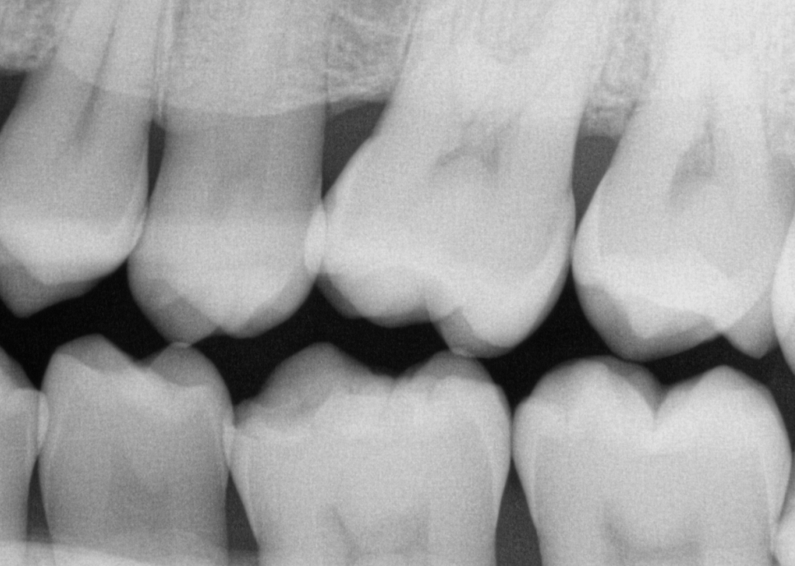
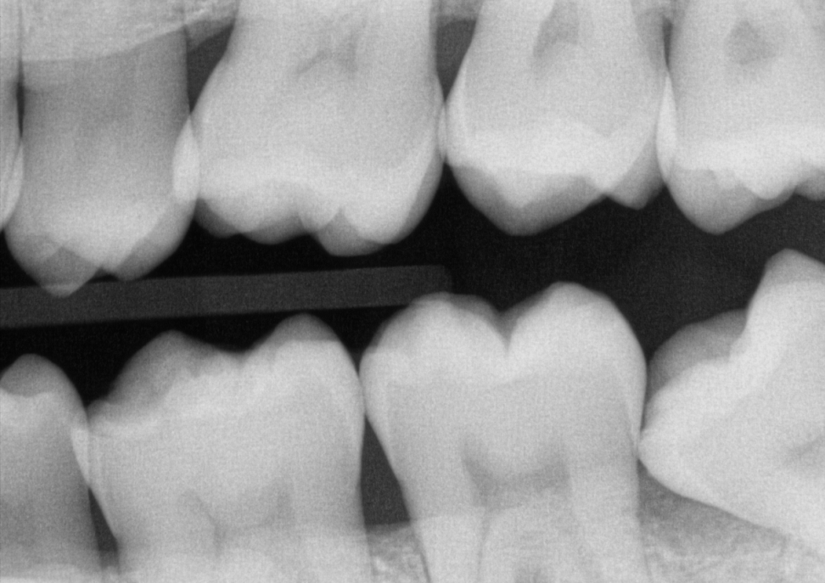
Post-op bitewings
Taken 11/20/25

Slide 28
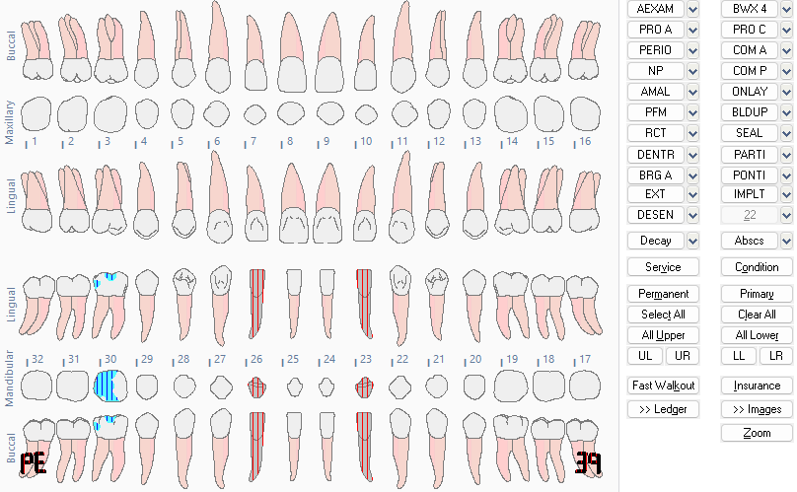
Dental Charting
Congenitally Missing Teeth:
#23 & 26
Composite Restorations: #30 DOBL
Partially-erupted Teeth:
#17 & 32
According to Dr.'s Exam...
Decalcified areas: #8 FI & 9 FI
Caries 19(O) & 30 (DO)

Slide 29
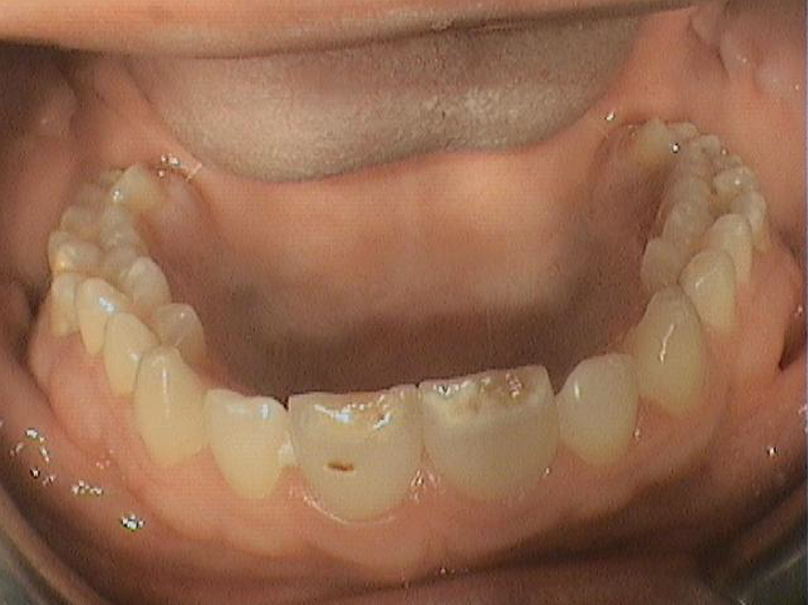
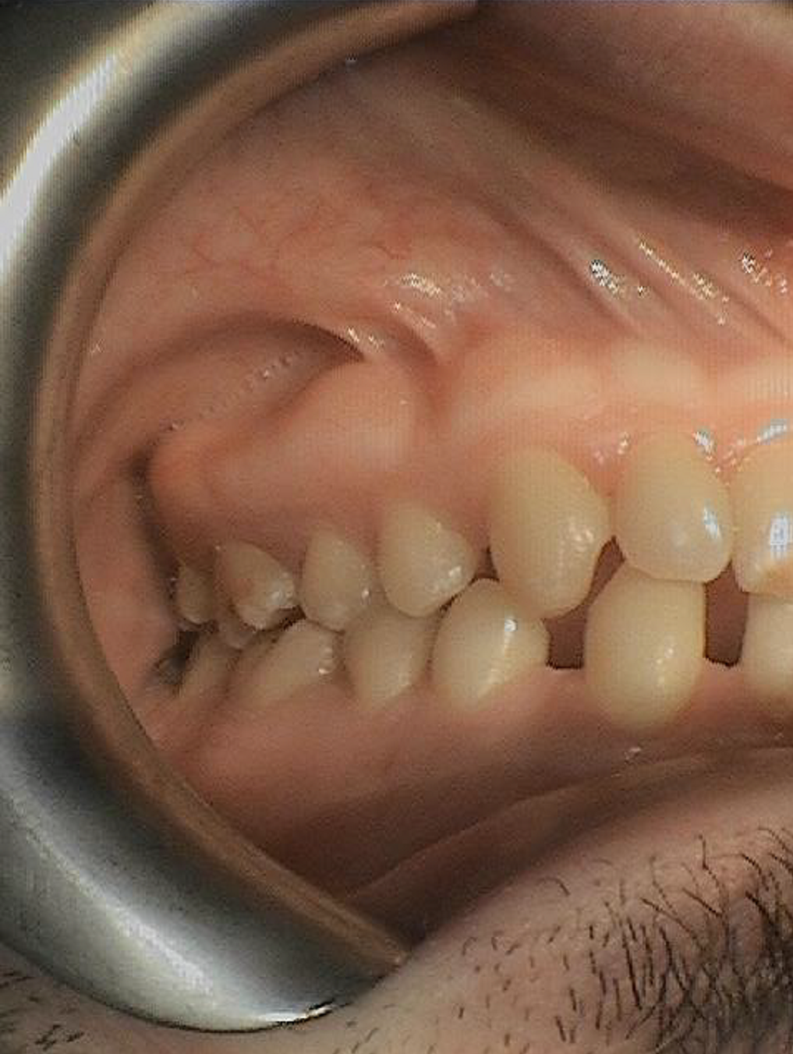
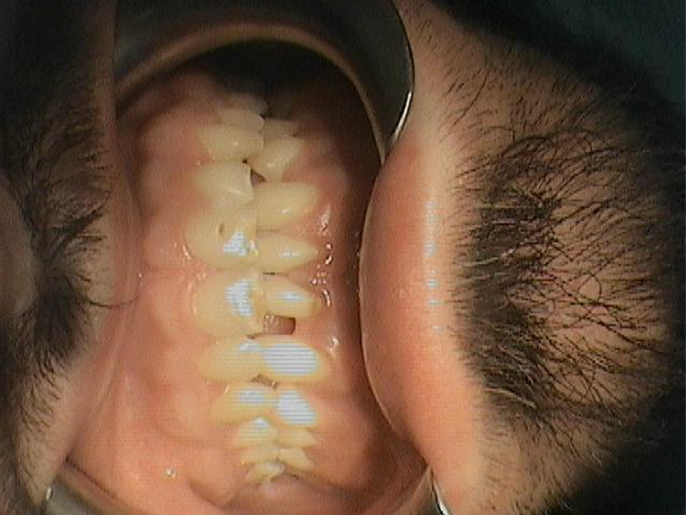
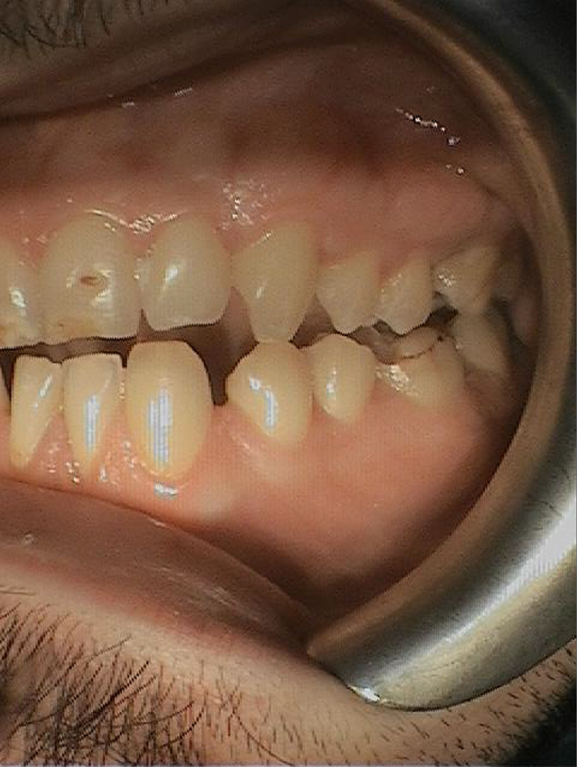
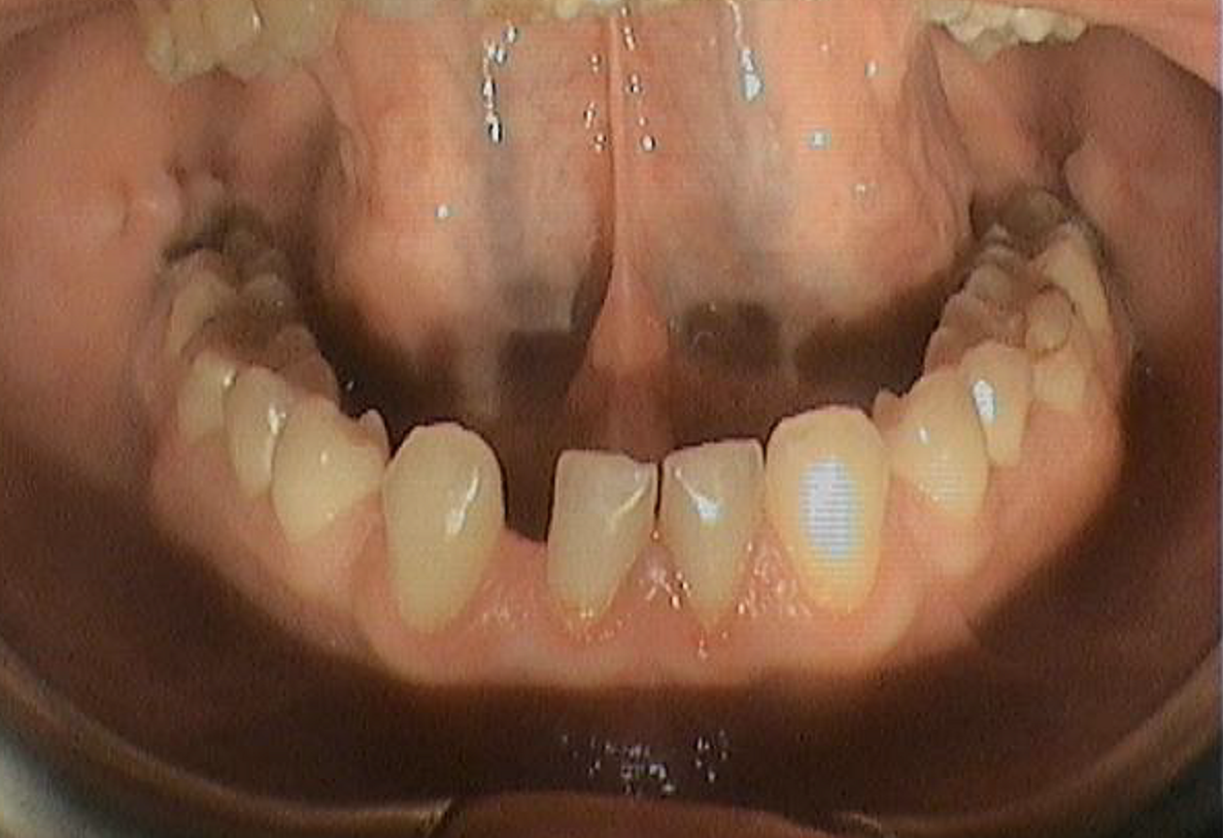
Intraoral Photos 1
Taken 10/21/25 (Before)

Slide 30
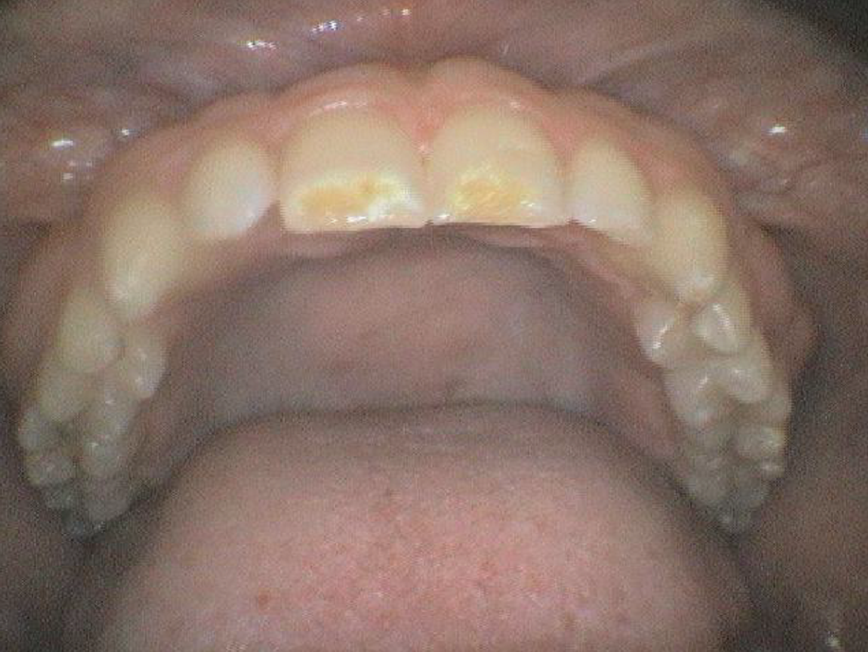
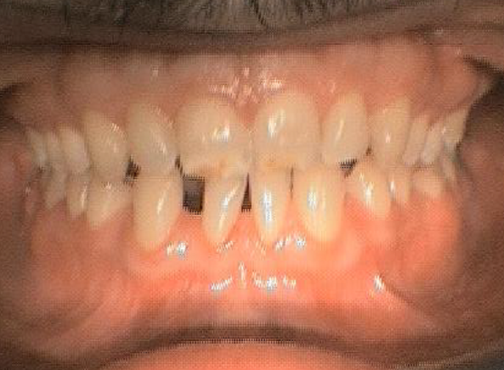
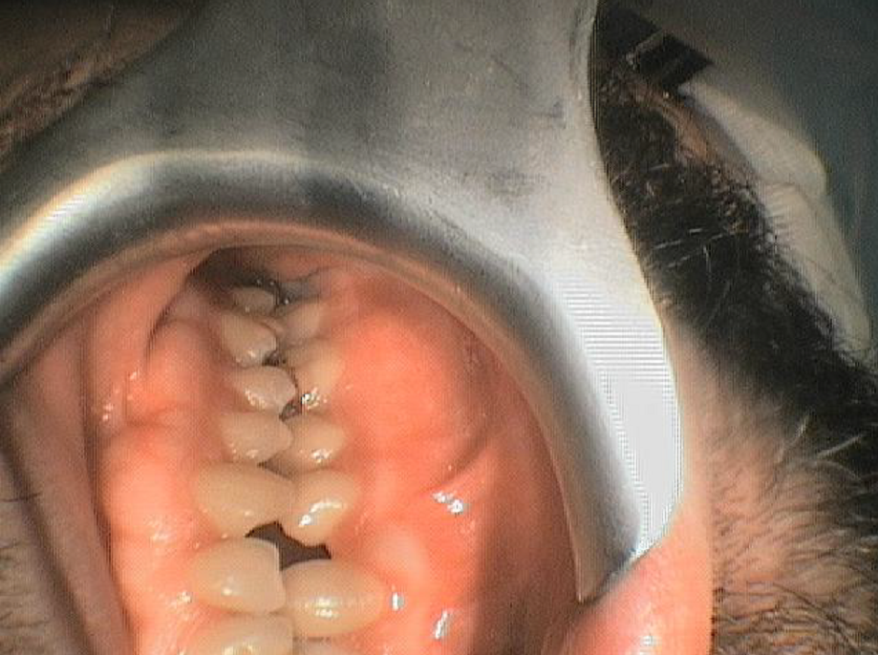
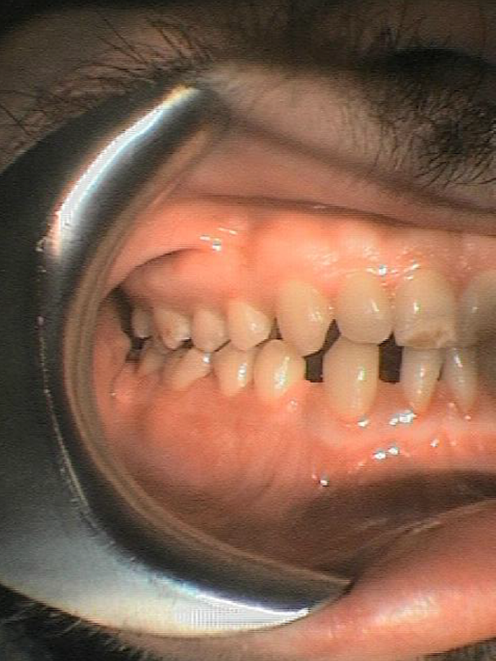
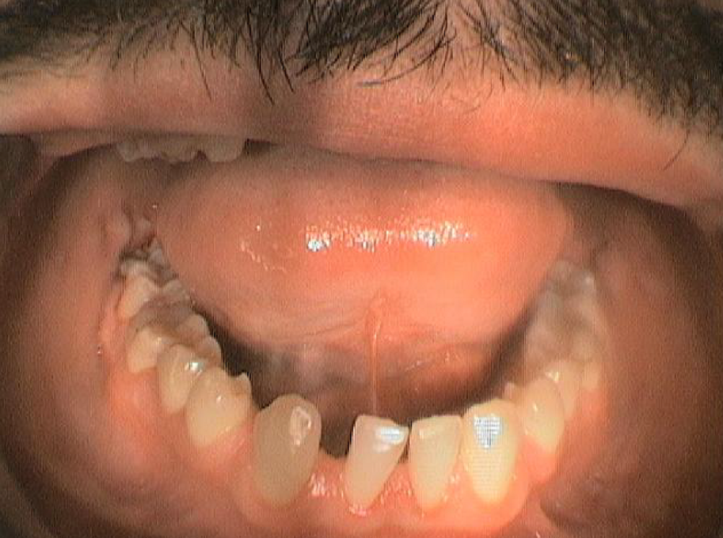
Intraoral Photos 2
Taken 11/20/25 (AFTER)

Slide 31
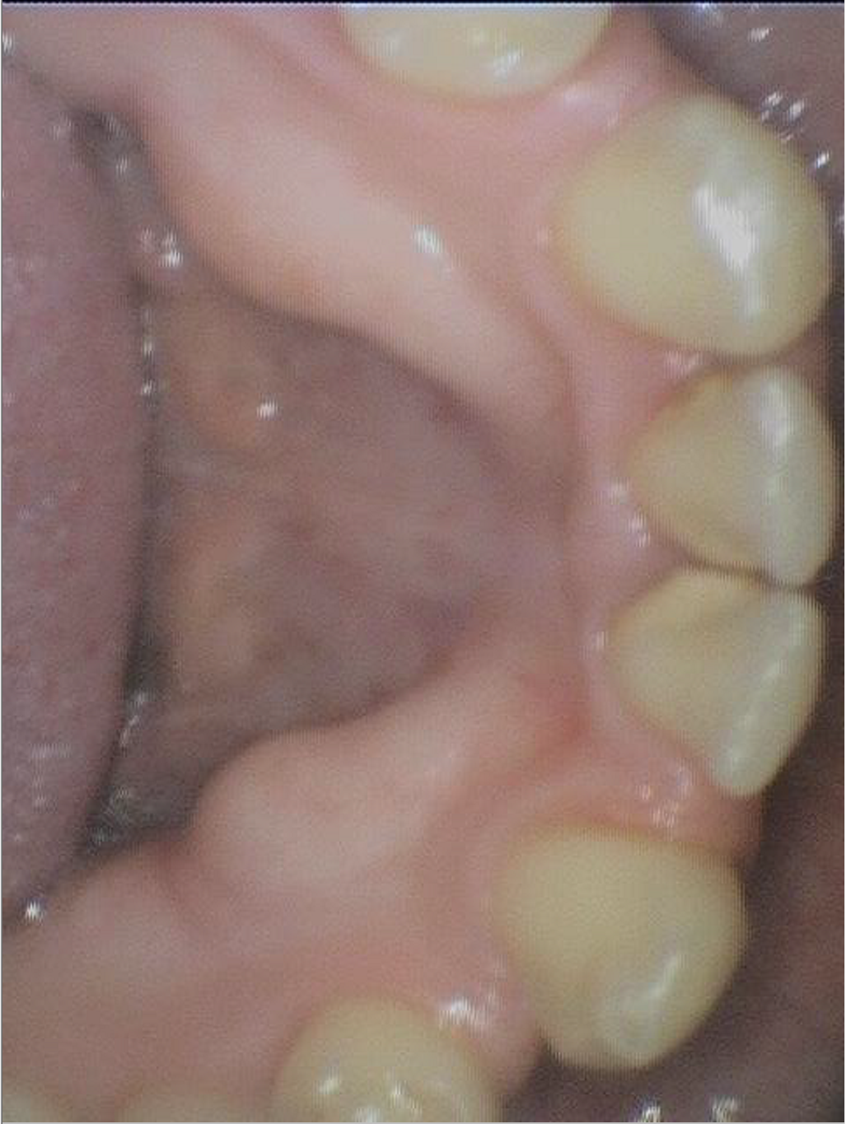
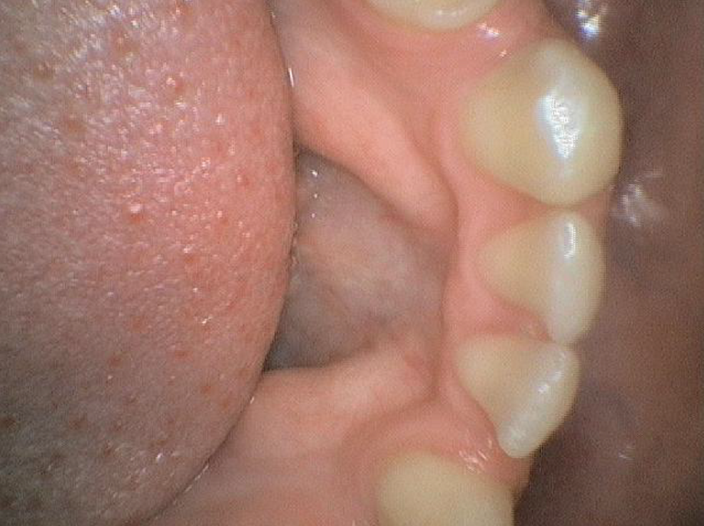
Intra Oral Photos- Lingual Bridge
Taken 10/21/25 (Before)​
Taken 11/20/25 (AFTER)

Slide 32

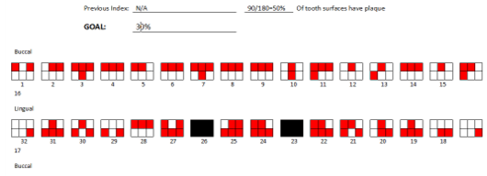

Plaque Index Score
50% surfaces had plaque, 30% is the goal
OHI implemented: Recommended Bass Method with bristles aimed 45 degrees towards the gingival margin and coverage of each surface and tooth & floss picks with the c-shaped flossing method and discussed with patient to use interdental brush for diastemas

Slide 33
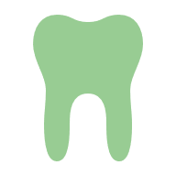
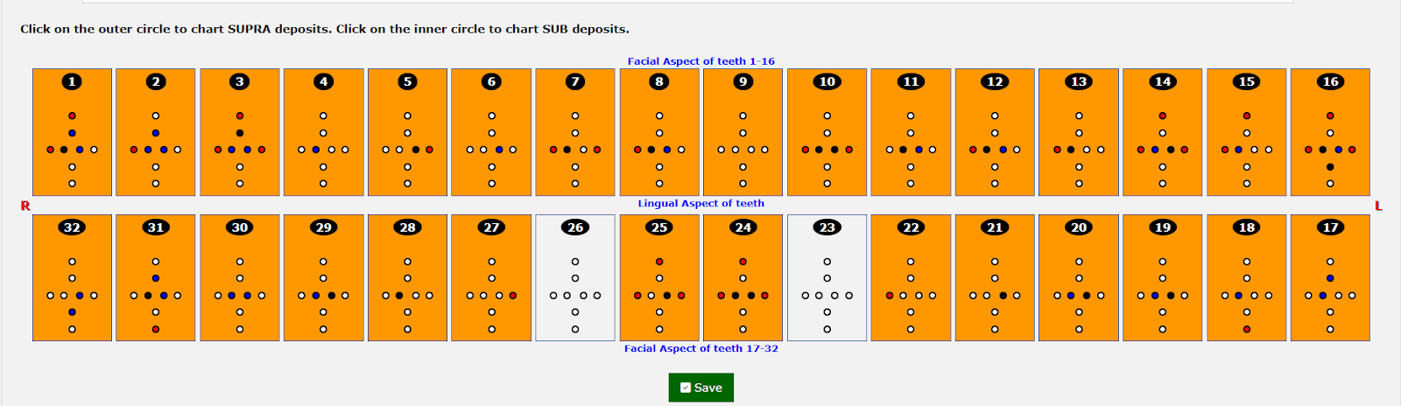
Calculus Deposit Assessment
Quadrants 1-4
Degree of Difficulty: C3

Slide 34
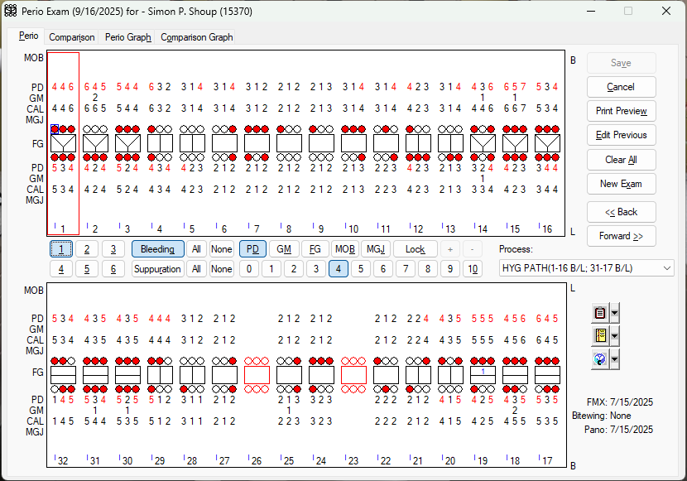
Periodontal Charting Assessment
Generalized bleeding on probing
Localized 4-6mm pockets on #1,2,3,4,5,6,10,11,12,13,14,15,16,17,18,19,20,21,29,30,31,32
Localized 7mm pocket on #15D
Localized 1mm of recession on direct buccal surfaces of #14,15,30, & 31 and on direct lingual of #14
Localized 2mm of recession buccal surfaces of #2 & 18
Class 1 furcation involvement on lingual of #19
Completed 9/16/25

Slide 35
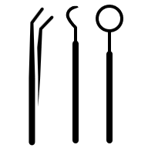
Periodontal Status Continued...
Quadrants 1-4
Perio P3
Gingival Statement: Generalized moderate marginal inflammation with generalized bleeding on probing
AAP Staging and Grading
Stage III Grade B

Slide 36
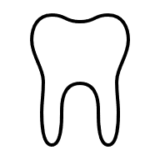
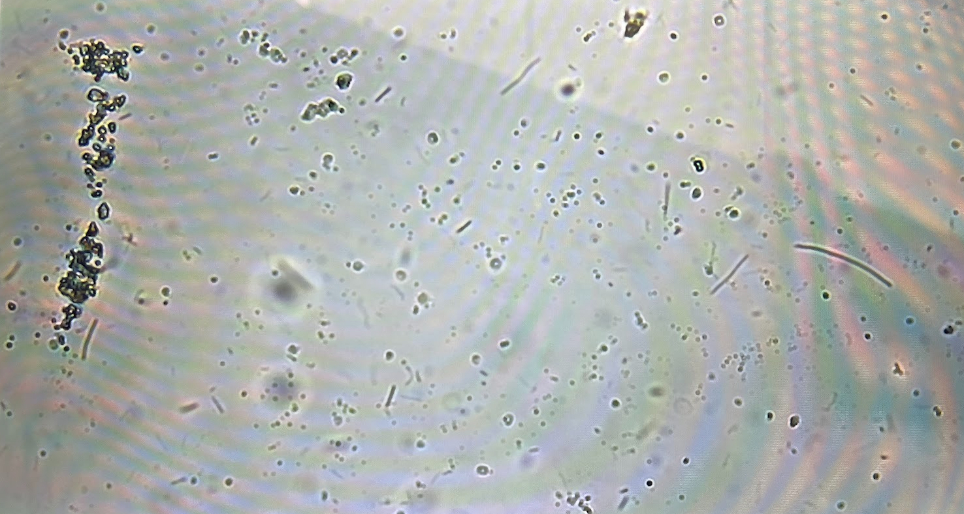
Phase Microscope I- 10/21/25
#15 DB
Findings:
Several filamentous rods (bacilli)
Several Spirochetes
Cocci in chains
Epithelial cells

Slide 37
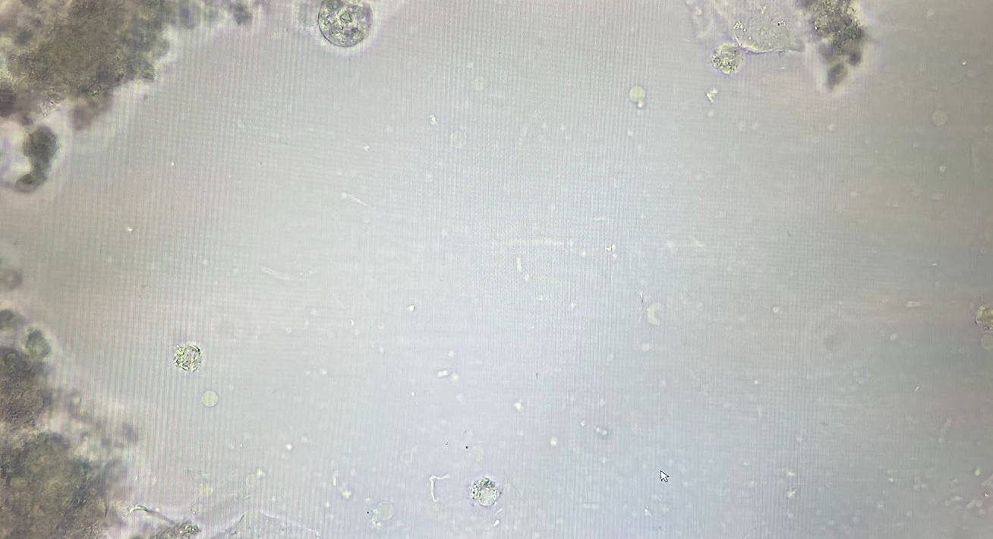
Phase Microscope 2- 11/20/25
#15 DB
Findings:
Epithelial cells
Few spirochetes and smaller chains
Several filamentous rods (bacilli)
*Phase Microscope 3 will be completed at re-eval appointment

Slide 38


Nutritional Counseling
2nd Appointment- 10/22/25
1st Appointment- 9/16/25
After reviewing his caries risk and gathering assessment data, I determined a need for nutritional counseling and the patient accepted. I began with explaining how vitamins and minerals such as calcium, phosphorus, and Vitamin D have specific roles in tissue and bone development and repair. I also explained carbohydrates and sugars and how they increase the pH in the oral cavity and can contribute to caries. I then left the patient with a 3-day food diary with instructions for the patient to complete and return at the next appointment.
After assessing his 3-day food diary and gathering assessment data, it was notable that the patient was lacking several food groups such as fruits, vegetables, and dairy was not meeting the nutritional needs for his age group. We discussed adjustments to his diet and created goals in which we could implement to improve his diet in order for him to obtain the proper nutrients, especially increasing his consumption of fruits and vegetables. He also admitted that he had a high consumption of ice cream which has high amounts of added sugars, causing in increased risk to caries and we produced healthier alternatives that would satisfy the patient and contribute to a healthier diet. I ended with reminding him how imperative it is for him to improve his diet in order for proper tissue repair and response following his SRP treatment.

Slide 39
Tobacco CESATION counseling
2ND APPOINTMENT- 11/6/25
1ST APPOINTMENT- 10/21/25
After obtaining the Tobacco Use Assessment Form and reviewing health history, there was an indication for tobacco cessation counseling, and the patient consented to proceed. I began by explaining why we perform oral cancer screenings and what we are looking for as well as how he can screen for lesions at home. I informed the patient of the detrimental effects that each cigarette, marijuana use, and vape had on the oral cavity. I then explained the differences he would see and the benefits he would have on his oral cavity if he were to follow through with tobacco cessation. I ended by giving him resources to aid him in quitting and cites that had more information and resources to help.
After asking the patient how progress going in regards to his tobacco cessation, he admitted that he was unsuccessful and smoked two days prior to the appointment. I again reminded him of the benefits of quitting and the negative impacts it has on the oral cavity. I also explained to him how cessation versus continuation would impact his response to SRP treatment and reminded him of the resources that were available to him. I encouraged him to keep making attempts even after failed ones. He responded that he does not think he would be able to accomplish this goal and lacked effort and intention at this appointment.

Slide 40
Section III
Dental Hygiene Care Plan & Treatment

Slide 41
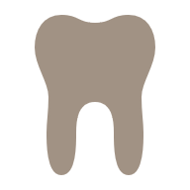
Dental Hygiene Treatment Diagnosis (ADPIED)
Assessment- Medical history, Radiographs, Calculus and Perio Assessment, Dental Charting, EOIO, Plaque Index, Tobacco Use Assessment Forms, and Nutritional 3-day food Diary
Diagnosis – Patient was diagnosed with AAP Stage III Grade B Periodontitis
Planning- Q1-4 SRP w/ use of local anesthetic, Nutritional Counseling, Tobacco Counseling, Patient education, 3 Phase Microscope, Oral Hygiene Instruction, Intraoral photos, Placement of Arestin in #15 DB pocket, Fluoride Varnish
Implementation- Complete and follow through correctly with each treatment phase as planned
Documentation- Every treatment phase and step was documented into Eaglesoft
Evaluation – Re-eval appointment will be completed after 6-8 weeks following SRP treatment

Slide 42
Treatment Plan
Date | Code | Description | Provider | Teeth/Quad | Status
7/15/25 | D0210 | 20 FMX | Breighlee Zimmerman |  | Proposed
7/15/25 | D0330 | Panoramic radiographic image | Breighlee Zimmerman |  | Proposed
9/16/25 | D1330 | Oral Hygiene Instruction | Breighlee Zimmerman |  | Proposed
9/16/25 | D1310 | Nutritional Counseling | Breighlee Zimmerman |  | Proposed
9/16/25 | D1320 | Tobacco Counseling | Breighlee Zimmerman |  | Proposed
9/16/25 | D4341 | Periodontal scaling and root planing- four or more teeth per quadrant | Breighlee Zimmerman | UR | Proposed
9/16/25 | D4341 | Periodontal scaling and root planing- four or more teeth per quadrant | Breighlee Zimmerman | LR | Proposed
9/16/25 | D4341 | Periodontal scaling and root planing- four or more teeth per quadrant | Breighlee Zimmerman | UL | Proposed
9/16/25 | D4341 | Periodontal scaling and root planing- four or more teeth per quadrant | Breighlee Zimmerman | LL | Proposed

Slide 43
Treatment Plan Continued...
D
Date | Code | Description | Provider | Teeth/Quad | Status
9/16/25 | D9210 | Local anesthesia not in conjunction with surgical procedures (Local anesthetic, Oraqix, Cetacaine, Gingicaine) | Breighlee Zimmerman |  | Proposed
9/16/25 | D4381 | Localized delivery ogf antimicrobial agents into diseased crevicular tissue, per tooth (Arestin) | Breighlee Zimmerman | #15DB | Proposed
9/16/25 | D0150 | Comprehensive Oral Evaluation | Dr. Chung |  | Proposed
9/16/25 | D0274 | Bitewings- four radiographic images | Breighlee Zimmerman |  | Proposed
9/16/25 | D0415 (x3) | Phase Microscope Slide- collection of microorganisms | Breighlee Zimmerman | #15DB | Proposed
9/16/25 | D0431 | VELscope- Adjunctive pre-diagnostic test of mucosal abnormalities | Breighlee Zimmerman |  | Proposed
9/16/25 | D0350 (x2) | Oral/Facial Images (Intraoral photos) | Breighlee Zimmerman |  | Proposed
9/16/25 | D1206 | Topical application of fluoride varnish | Breighlee Zimmerman |  | Proposed

Slide 44
TImeline of care
7/15/25 (AM)
Radiology Day
CAMBRA Caries Risk Assessment Form
9/16/25 (AM)
Assessment
9/16/25 (PM)
1st set of Intraoral Photos
10/21/25 (AM)
SRP Q1
10/21/25 (PM)
Finish SRP Q1
11/6/25 (AM)
SRP Q2
11/6/25 (PM)
Treatment
11/20/25 (AM)
Phase Microscope #2
11/20/25 (PM)
Radiology Treatment Plan
Panoramic
20 FMX
Calculus Q2-4 Assessment
Assessment
Perio Q2-4 Assessment
Plaque Index
Oral Hygiene Instruction
Treatment Plan
Calculus Assessment Q1
Perio Assessment Q1
Final Treatment Day
Fluoride Varnish
Polish
SRP Q4 (#30-32)
2nd set or Intraoral Photos
Post-op 4HBW
SRP Q4 (25-29)
Treatment
1st Nutritional Counseling
Phase Microscope #2
Treatment
Retake Intraoral Photos
VELscope
2nd Nutritional Counseling
1st Tobacco Cessation Counseling
Trreatment
Treatment
SRP Q3
Arestin Placement #15DB
2nd Tobacco Cessation Counseling

Slide 45
Motivational techniques
Using Maslow's Hierarchy of Needs, I developed individualized motivational techniques for this patient. I established goals that were realistic for the patient and inexpensive due to low-income. The patient mentioned a dislike for the appearance of his teeth, so I educated him on ways to improve his OHI to help increase his self-esteem. I adjusted my recommendations to help him achieve health which is incorporated into the safety and physiological needs, such as the recommendation of incorporating fruits and vegetables in his diet in order to obtain the proper nutrients for repair and for the health of his periodontal state. Goals were created with the input of the patient's ideas and thoughts. For example, reducing plaque levels from 50% to 30% and brushing more than one time per week by beginning with three or four days, then eventually daily, until twice a day is accomplished, as well as asking the patient what foods he preferred so that we could try to incorporate those in his diet. I referred to resources that could assist the patient with tobacco cessation when counseling was indicated. I used intraoral images, phase microscope slides, and radiographs to directly show and explain his periodontal status and ways that he can remove plaque accumulation that occurs due to the large spaces created from his congenitally missing teeth. The patient was unaware of basic OHI techniques, so his education was designed to show and explain recommendations that were easy for him to understand.
Maslow's Hierarchy of Needs
Self-Actualization
Love and Belonging
Esteem
Physiological (Basic Needs)
Safety

Slide 46
Patient's Response
The patient was very willing and excited to have his teeth cleaned at no cost, especially as it had been quite some time since previous dental treatment was performed. He was thrilled for the opportunity for his indicated treatment as he thanked me following each appointment. Patient showed up for each appointment and never canceled which displayed that he wanted to receive his treatment plan.
Patient struggled to make adjustments outside of the office, despite education and recommendations. Advice given through oral hygiene care at home, nutritional and diet changes, and goals created were not met by the final treatment phase. The patient listened attentively and mentioned that he found the information I offered interesting and useful, but failed to make changes to tobacco use, diet, and oral hygiene care.
Overall, the patient was thankful for the education and care we administered to him through his phases of treatment .

Slide 47

Justification of Recommended Treatment
20 FMX: Since it had been over 10 years since his previous x-rays we recommended a full mouth survey to locate any bone loss, interproximal caries, or presence of pathologies in the entire mouth
Panoramic: We recommended this x-ray to establish a baseline for this patient and obtain an entire picture of the patient's state and assess for pathologies not captured in the 20FMX
Plaque Index and OHI: To locate surfaces patient is not properly removing during brushing and discover areas that accumulate the most biofilm to focus on when brushing. Also, explain methods and techniques such as frequency of proper brushing, brushing techniques, and interdental care specific for the patient. The next plaque index will display progress on biofilm removal from patient education and previous removal.
Periodontal Assessment: To located pockets, areas of bone loss, establish a type of treatment (SRP or prophy), and determine periodontal status based on AAP staging and grading, and track periodontal status and bone loss progress
Calculus Assessment: Discover locations of calculus to ensure removal of calculus present on each tooth surface and supragingival or subgingival
Nutritional Counseling: Due to a high caries risk, this patient indicated a need for adjustments to diet and nutritional education to obtain proper nutrients for his oral health, tissues, and bone
VELscope: indicated due to present and previous tobacco use to ensure no oral lesions present were oral cancer and evaluate oral tissue health
Intraoral Images Before and After Treatment: To evaluate difference before and after treatment and for patient education
Tobacco Counseling: Indicated due to use of multiple types of tobacco products both used past and present and to educate this patient on cessation in order to improve his healing and tissue response from SRP
Phase Microscope Samples: Indicated to show patient the bacteria present in his deepest pocket and increase motivation and understanding of the reasons behind his periodontal state. As well as show the improvements and decrease in bacteria (gram + and gram -) in response to SRP and improve oral-home care
Anesthesia: Was prescribed for Q1-4 to increase patient comfort during calculus removal and allow proper removal of calculus from the clinician, especially subgingivally due to generalized pocket depths >4mm.
SRP Q1-4: Indicated due to bone loss present and Stage III Grade B periodontitis with calculus located both supra and sub.
Placement of Arestin: The use of this antimicrobial was placed in his deepest pocket located on #13DB to decrease pocket depth and decrease bacteria to disable further progression of destruction.
Post-Op 4HBW: We recommended this to ensure all calculus was successfully removed
Fluoride Varnish: Indicated due to presence of caries and decrease risk of future caries development, especially since patient was unexposed to fluoridated water during childhood.

Slide 48

Outcomes
After each Quad completed SRP treatment, there was a reduction in the accumulation of biofilm along the gingival margin and the gingiva color changed from red to slightly pinker. There was still slight marginal inflammation due to patient's lack of at home oral hygiene care
Patient reposted teeth feeling smooth and separated (due to removal of calculus located interproximally)
**6-8 week reval appointment- indicated to assess further evaluation of periodontal status in response to SRP, perio assessment will be expected to display possible reduction of BOP and pocket depths

Slide 49
Section IV
Summary
***6-8 Reval Appointment will occur in 2026

Slide 50
Patient and Tissue Response
Patient Response
Tissue Response
Regardless of my education, treatment given, and directions, I expect that the patient will not respond well to strategies I have given him. I do not believe that he will implement them due to lack of motivation, and he is less concerned about his oral health as he is focused on work and providing for his daughter.
Prior to treatment, the patient's gingiva was generalized moderate inflammation, boggy, and red. Following treatment, it was notable that the patient's tissues were pinker in color and only slightly generalized mild inflammation due to plaque present because the patient was still not brushing as directed. I expect the tissues to slowly revert back to how they were until the next treatment/cleaning.

Slide 51

Modifications of Therapy
Increase patient motivation through a more thorough explanation and visual aids. This information is derived from lack of change in oral-care routine at home and lack of success in patient dietary goals and tobacco cessation.
Show plaque coloration in depth more for re-eval appointment with a thorough explanation if plaque score has not decreased from previous score.
Increase patient engagement and motivation to improve oral health status.

Slide 52

Goals
Goals Met: Patient was educated on ways to improve his oral health such as brushing techniques, flossing, and how to perform oral cancer screenings on self as well as what to look for. The calculus found was completely removed for each tooth surface and the gingiva was healing. Patient tolerated anesthesia well and I expect to see a reduction in pockets, especially #15DB where the Arestin was placed.
Unachieved goals: Patient did not make changes to oral home care routine and was still unmotivated to achieve improved oral health. The patient also did not make changes to improve plaque index score, their diet, or decrease his use of tobacco products. Patient was left still unmotivated and displayed little interest in making improvements that he was educated with. Calculus was not removed entirely prior to post-op bitewings taken, but later this calculus was fully removed. Changing appearance of #8 & 9 and intrinsic yellow staining

Slide 53
Recommendations/ Future Plan
Regular dental cleanings: perio maintenance
6-8 week re-eval &f follow-up care, moitoring
Brushing at least twice a day using the Bass Method for two minutes to ensure proper biofilm removal
Floss at least once a day using the c-shaped technique
Make dietary changes and increase consumption of fruits and vegetables
Tobacco cessation
Avoid irritants such as alcohol and smoking
Whitening
Restorations/ fillings on 19(O) and 30 (DO)

Slide 54
Clinician's Experience and Opinion
I believe that the patient was very thankful to receive treatment considering how long it has been since his last cleaning and was thankful for the services provided especially after acknowledging the cost of SRP, and anesthesia, at a regular dental office. I do not believe I was able to entirely capture this patient's engagement and that each appointment, he left with a healthier quadrant due to calculus removal, but he did not comprehend the changes that he would have to make daily to ensure health of his entire periodontium. I think the patient would have success if regular appointments were made, and he attended them to remind him of areas of improvement and information that could improve his motivation. I was not pleased that I failed to motivate him entirely and convince him to follow-through with my recommendations outside of the clinic. Overall, I was content with the patient's response as well as the tissue response following the removal of calculus. I noticed a significant increase in esthetics and an enormous change from halitosis to a fresher oral cavity. I was grateful the patient had enough motivation to show up for each appointment and understood that the care he received was an important start for him to get him on the right track of increased oral health.

Slide 55
References
Background Photo:
  iStock. (n.d.). Dentist background 02-02 [Illustration]. iStock. https://media.istockphoto.com/id/1249785016/vector/dentist-background-02-02.jpg

